Slide 1
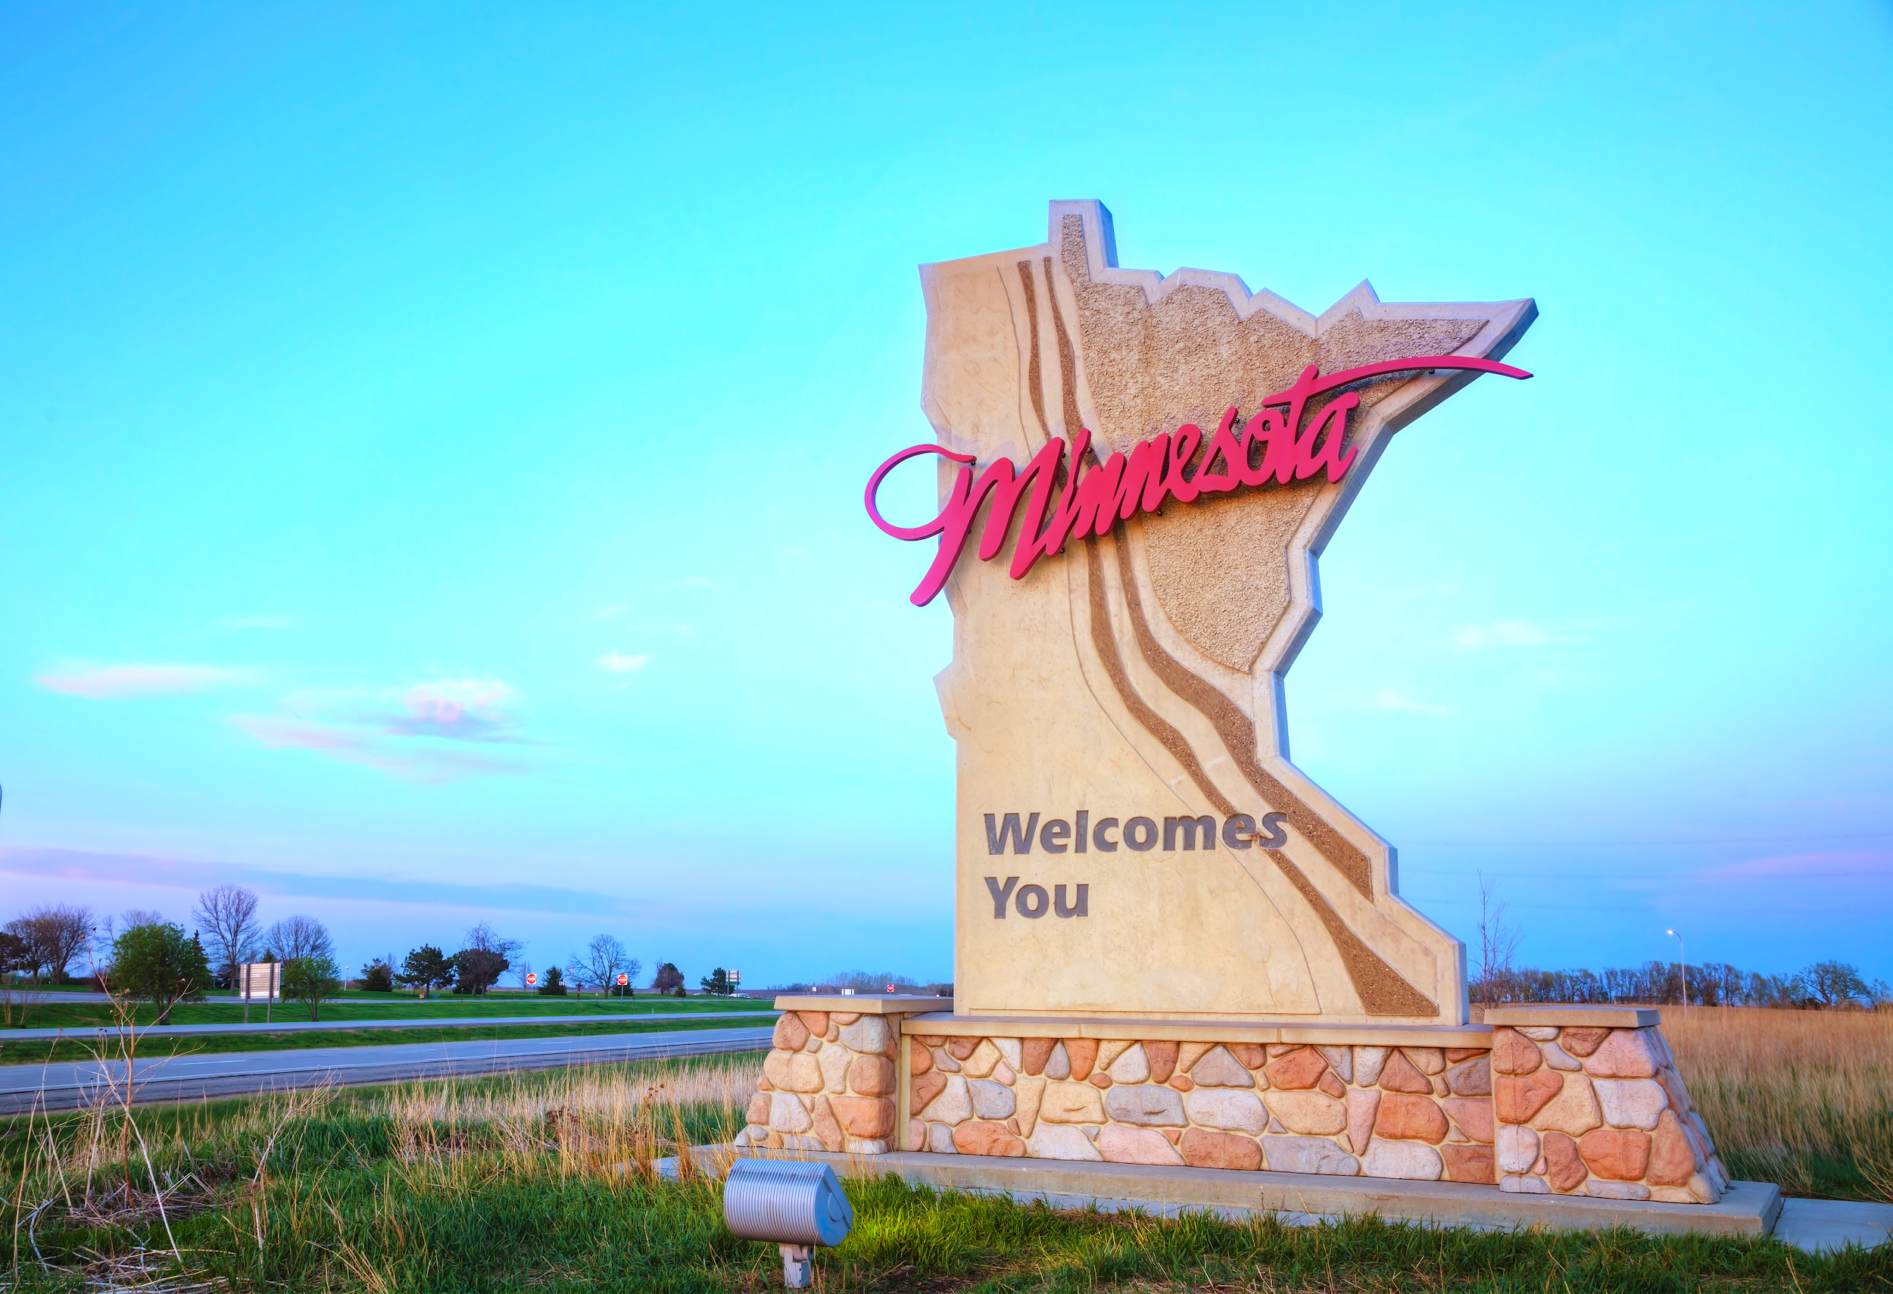
Team Metro
CS 5010 Project
Jordan, Pantea, Jae, Kaleb
Notes:
Pantea

Slide 2
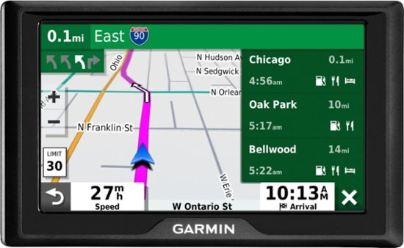
Introduction
Goal: Analyze traffic data to discover patterns in traffic volume
Used to estimate duration of a trip in advance (mimic a GPS)
Find relevant patterns in historical data
Analyze factors that may influence traffic volume:
Time of the day, time of the year, holidays, and weather conditions
Notes:
Pantea

Slide 3
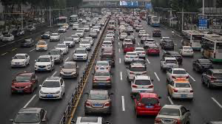
Data
Traffic volume for a highway in Minnesota (connects Minneapolis to St. Paul)
From UC Irvine Machine Learning Repository
6 years; 47,000 data points
Dataset includes:
Date/time, holiday
Temperature, weather conditions
Hourly traffic volume
Notes:
Jordan

Slide 4
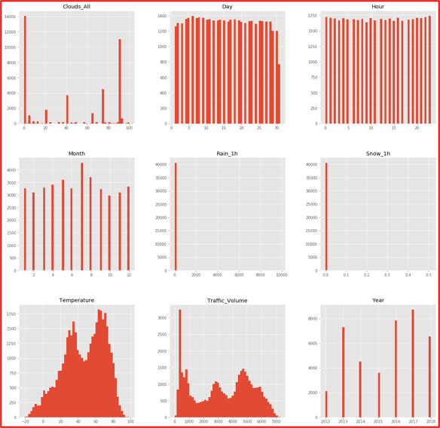
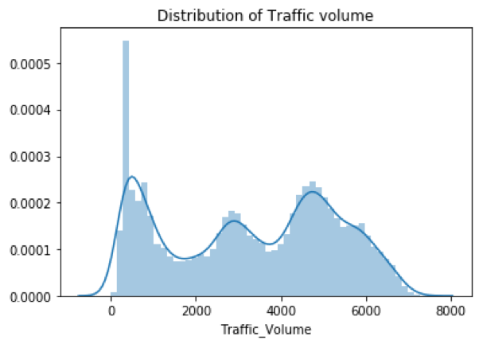
Data
Notes:
Jordan

Slide 5

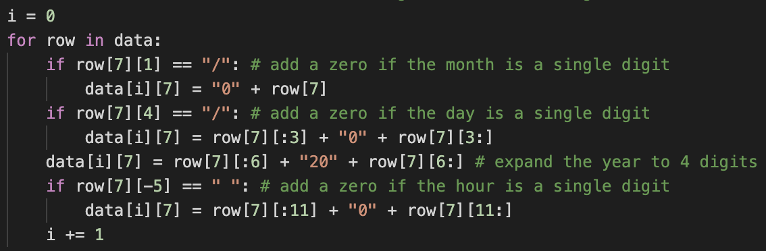
Data Cleaning
Strip whitespace
Type cast
Date/time format: “mm/dd/yyyy hh:00”
Append new columns
Notes:
Jordan

Slide 6
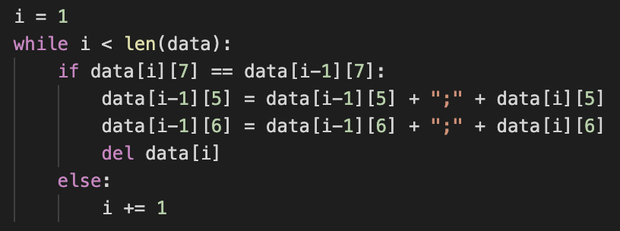

Data Cleaning
Inconsistent holidays
Duplicate data
Convert temperature to Fahrenheit
Store in a pandas dataframe
Notes:
Jordan

Slide 7

Key Questions
Can we identify rush hour times?
Does traffic vary by time of year?
Do holidays follow abnormal patterns?
Does temperature affect traffic?
What is the impact of weather on traffic volume?
Notes:
Jae

Slide 8
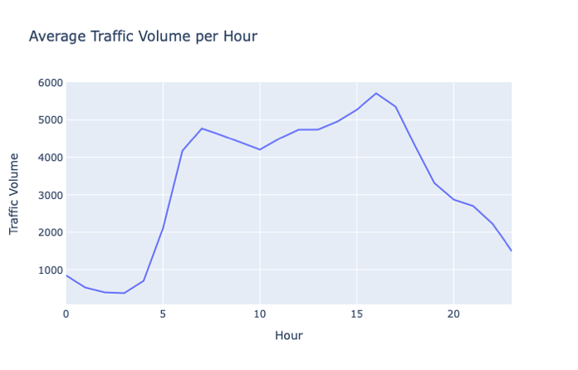
Hourly Traffic Patterns
Rush hour peaks
Small lunch rush
Low nighttime traffic
Notes:
Pantea

Slide 9
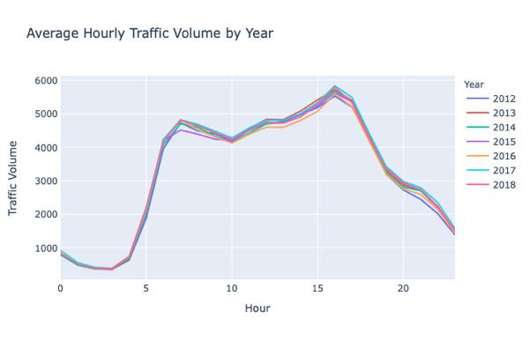
Hourly Traffic Patterns
Same trend over six years
Little variation in volume
Notes:
Pantea

Slide 10
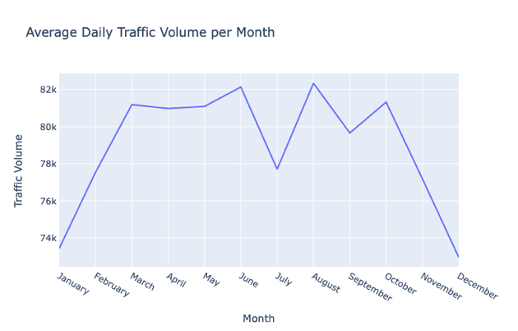
Monthly Traffic Patterns
Lower in winter
Big dip in July
Notes:
Kaleb

Slide 11
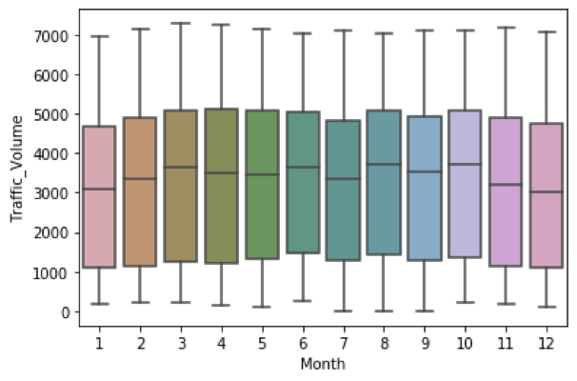
Monthly Traffic Patterns
Similar variation seen
Less pronounced on hourly level
Notes:
Kaleb

Slide 12
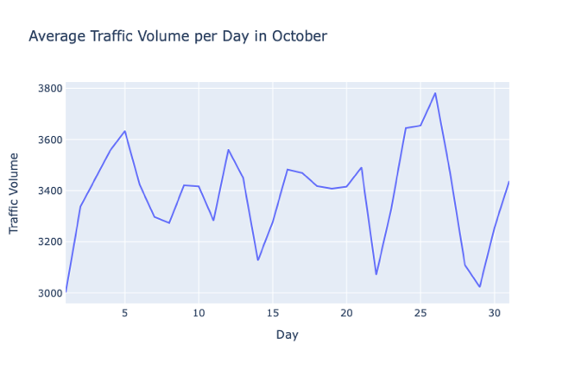
Monthly Traffic Patterns
No consistency
Weekdays vs. weekends may play a role
Notes:
Kaleb

Slide 13
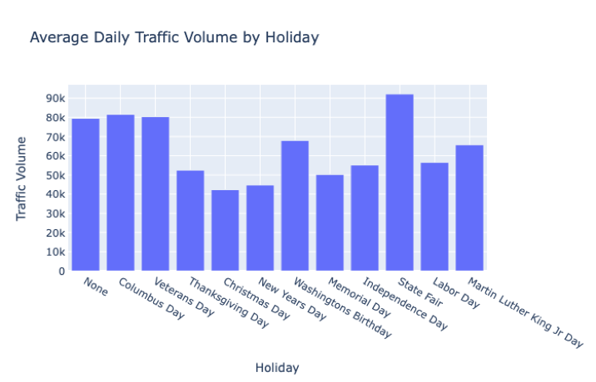
Holiday Traffic Trends
Reduced traffic on some major holidays
Big increase for the State Fair
Notes:
Jordan

Slide 14
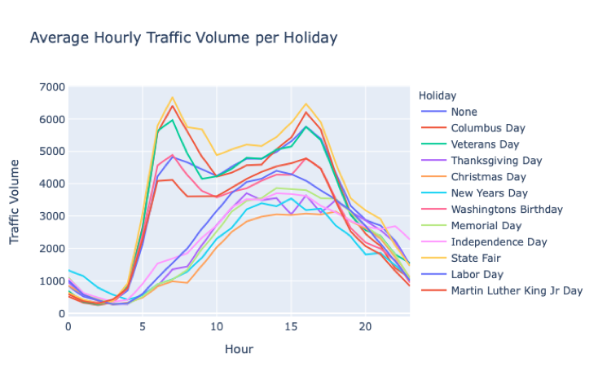
Holiday Traffic Trends
No morning peak for some holidays
All have some form of evening rush hour
Notes:
Jordan

Slide 15
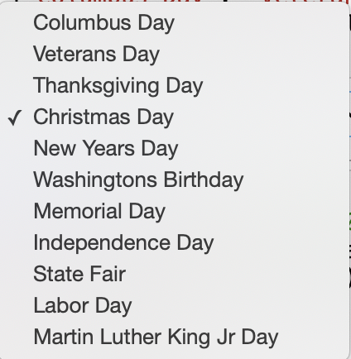
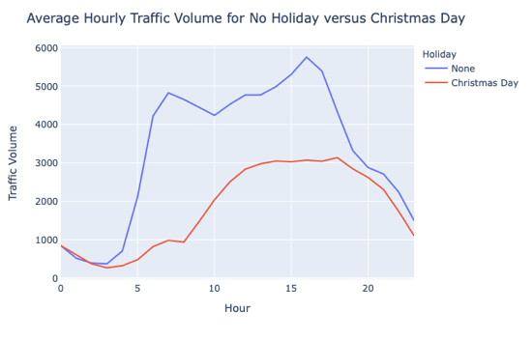
Holiday Traffic Trends
Easier to compare
User Interaction
Notes:
Jordan

Slide 16
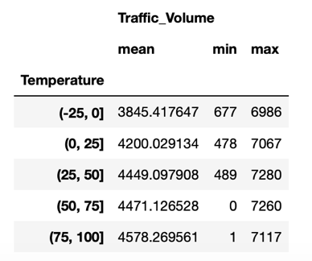
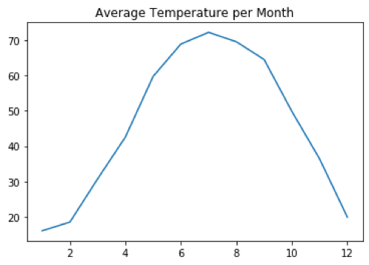
Temperature
Table excludes 10pm-6am
Reduces bias as night hours tend to be colder and have less traffic
Notes:
Jae

Slide 17
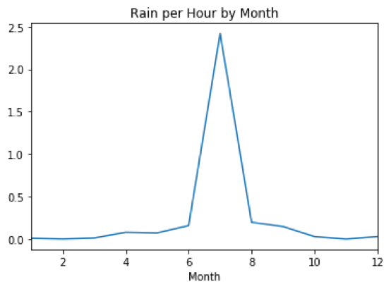
Rainfall
Large peak in July
Remember the reduced traffic in July? Let’s see it again
Notes:
Jae

Slide 18
Monthly Traffic Patterns
Lower in winter
Big dip in July
Notes:
Jae

Slide 19
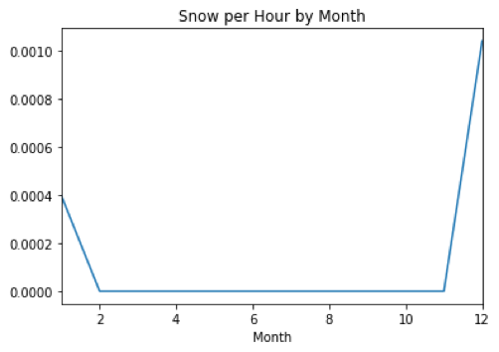
Snowfall
Peaks in winter
Corresponds to reduced winter traffic
Notes:
Jae

Slide 20
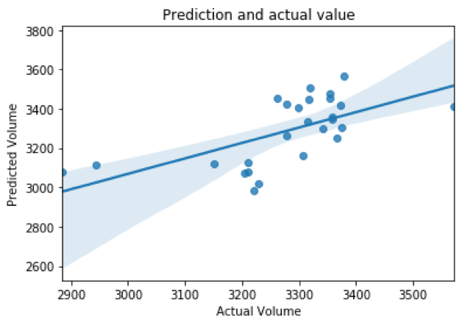
Multiple Linear Regression
Initial attempt
Would expand modeling further given more time
Notes:
Kaleb

Slide 21
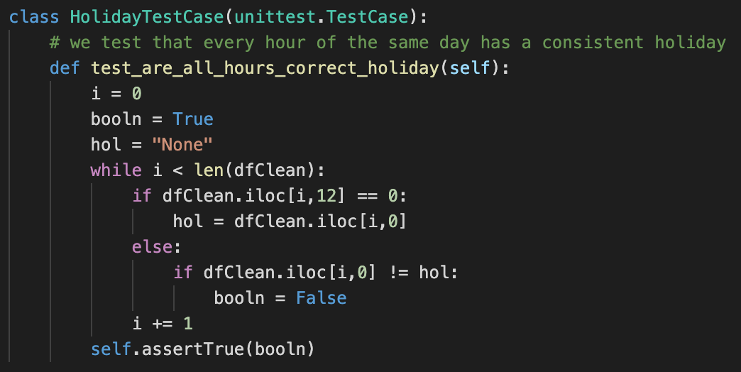
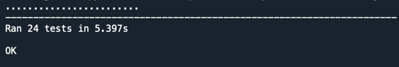
Testing
Data types
Date/time format: “mm/dd/yyyy hh:00”
Appended columns
Holiday consistency
Unique datapoints
Temperature conversion
Notes:
Jordan

Slide 22

Conclusion
Meaningful patterns related to date/time, holiday, rain/snow
Areas for further analysis: temperature, cloud coverage, weather description
We learned a ton about data cleaning and visualization!
Notes:
Pantea

Slide 23

Questions?
Notes:
Pantea

